Slide 1
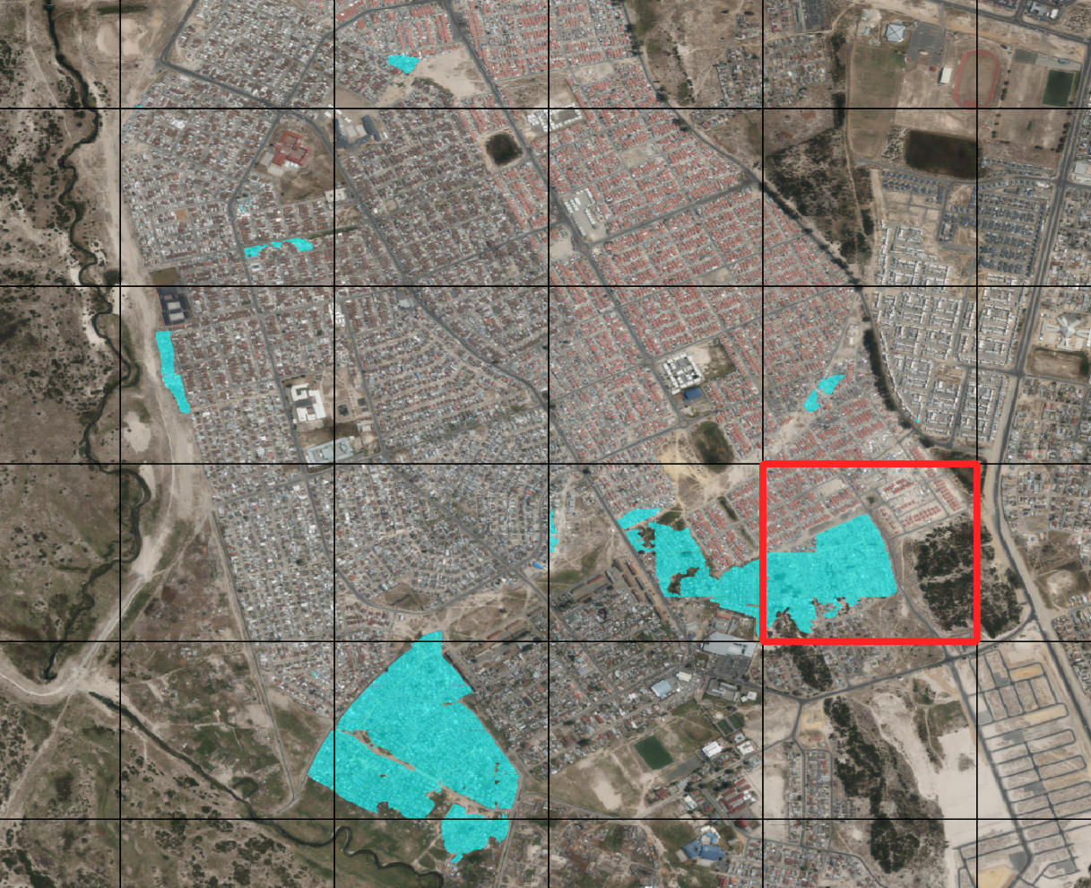
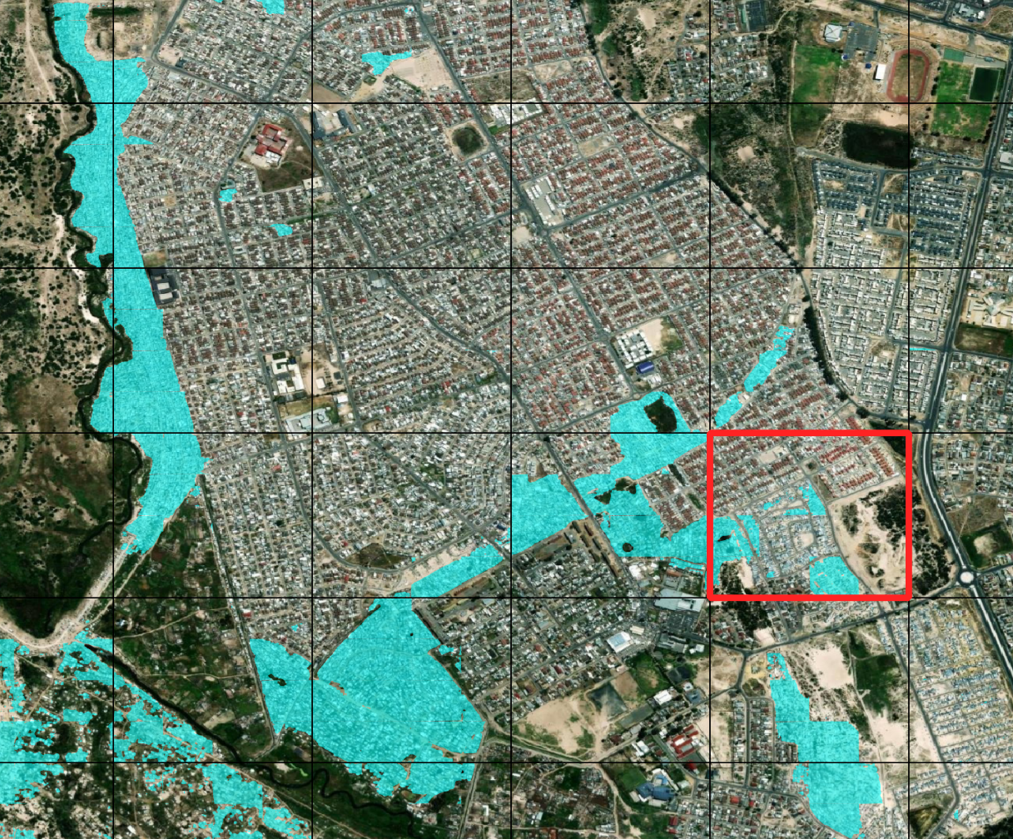
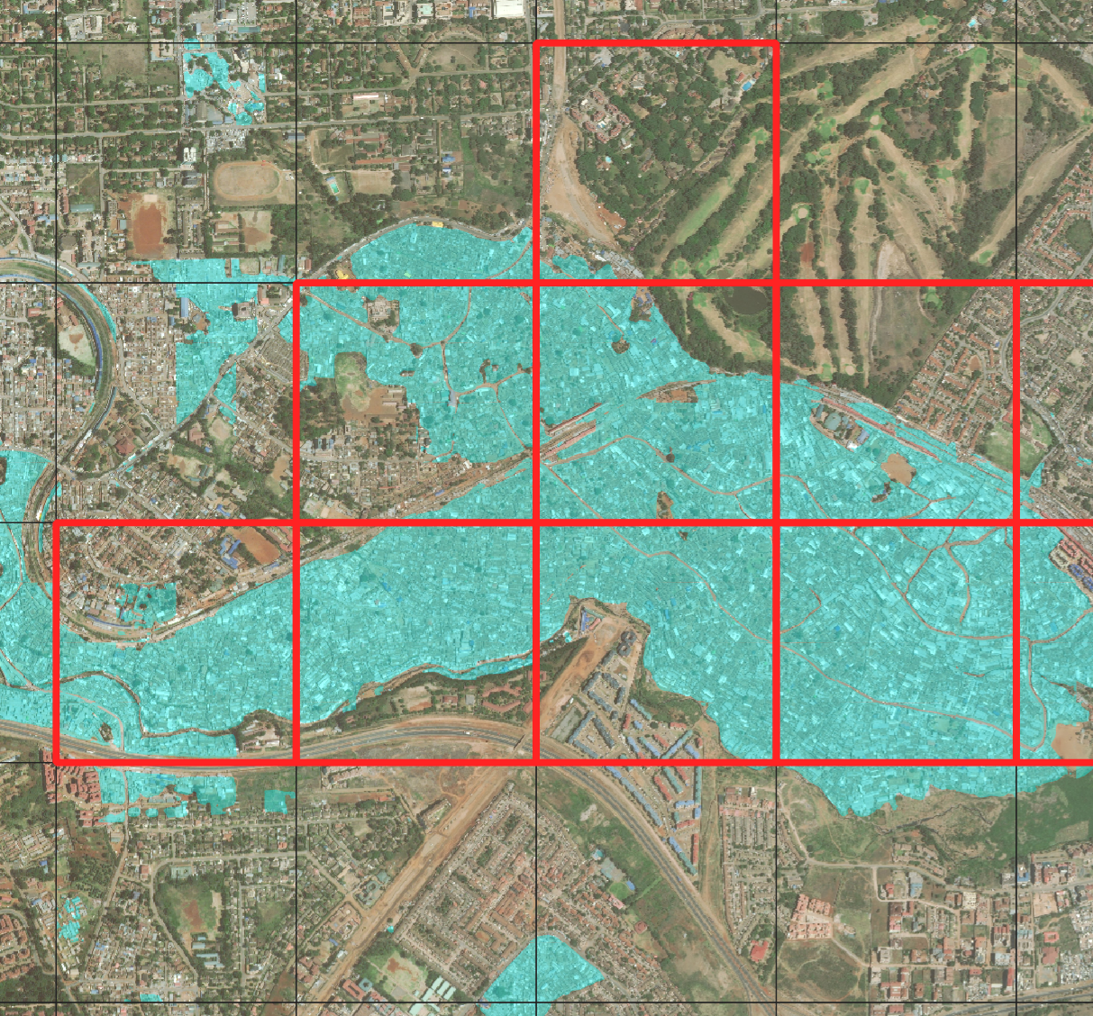
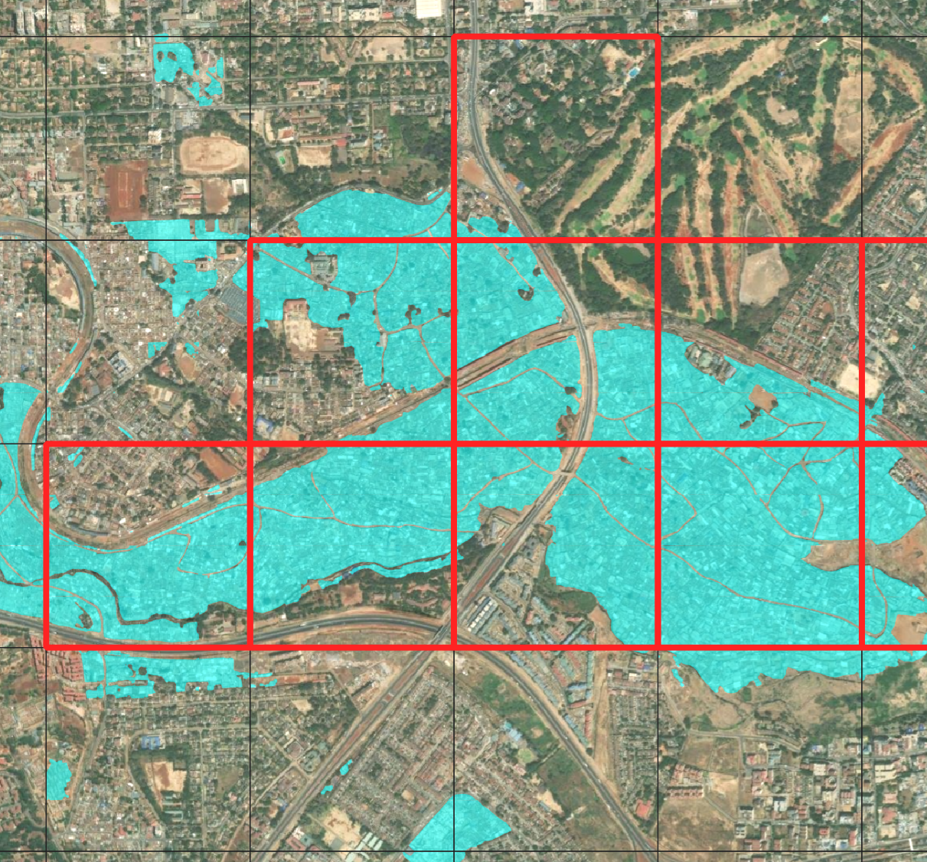
2019 JAN
Cape Town: Slum upgrading project
2023 JAN
-33.9869
-34.0085
18.6641
18.6901
0
500
1,000 m
Nairobi: Highway construction project
2019 FEB
2023 FEB
-1.3011
-1.3240
26.7752
36.8004
0
500
1,000 m
Detected slums
Redevelopment site

